Slide 1
Digital tools to mobilize on policy
Discussion on BTC communications

Slide 2
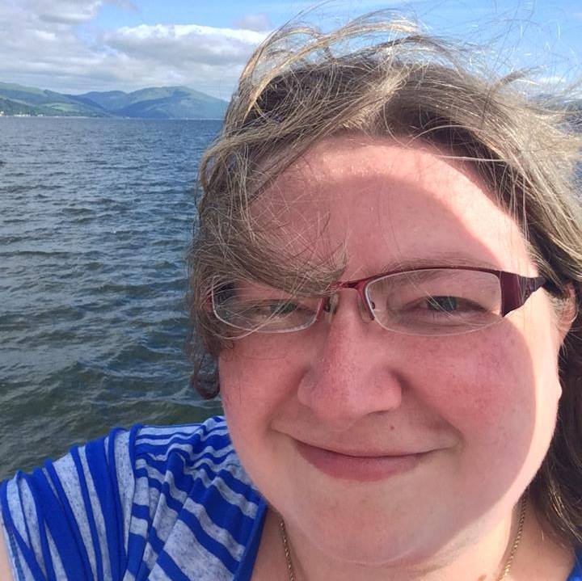
Welcome
Mel Umbarger
Budget & Tax Center Senior Communications Specialist
mel@ncjustice.org
linkedin.com/in/melumbarger
Notes:
Who I am, my background, how I came to this work

Slide 3
Overview
Our philosophy: Failure is an option
15 Days of Action
Digital Advertising
Texting successes
Notes:
What year or years does this cover?

Slide 4
BTC Communications Strategy
Strategize
What we want to happen
Who can make it happen
How to measure results
Make a plan
SMARTIE goals
Target our audiences
Plan to track results, quant and qual
Experiment
Fail
Learn
Change
Succeed
Document
Do it again
Keep iterating
Success
Goal

Slide 5
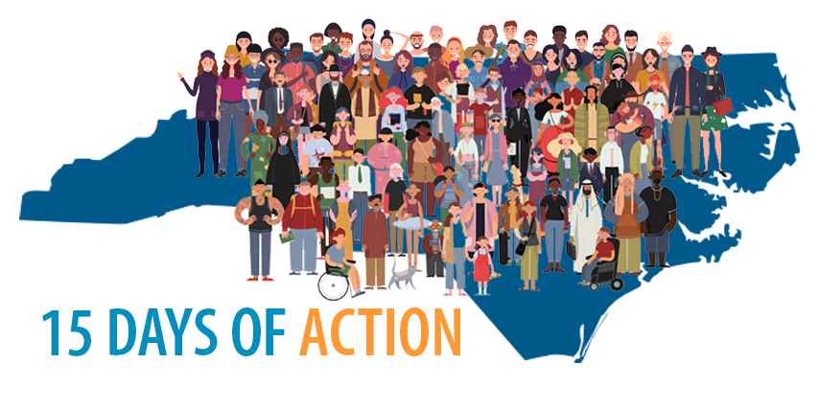
15 Days of Action Campaign
Notes:
We did this in the 15 days leading up to the beginning of the session

Slide 6
Planned 15 accessible, quick, and interesting actions people could take

Slide 7
Quantitative and qualitative analysis of results
“Great idea. I am overwhelmed by calls to give, zoom meeting invitations, AND ads for body armor. Your daily action suggestions allowed me to pick and choose and not to feel guilty if I had no energy / initiative at that moment. Your actions and information gave me a way to further my local efforts. I trust your organization to provide me with effective research.”
“thank you for providing this resource in bite sized portions which made complex issues easier to understand”
“Informative, proactive and focused on clear policy issues that NC needs to address”
“It was an interesting change from the usual kind of stuff” … “liked emphasis on self-care was included”

Slide 8
Quantitative and qualitative analysis of results
People on our email list who opened at least one 15 Days email: 4,705
212 people opened ALL of the 15 Days emails
570 of the people who opened one of these emails came from a Facebook lead ad last year
Of the 367 people who signed the federal petition, 92 left public comments.
Day 1 email click-through rate was 8.17%. Nonprofit average is 2.6%. 190 messages sent to lawmakers.
Average click-through rate over 15 days was 5.43%
Take out the 2 days with nothing to really click on, it goes up to 5.96%

Slide 9
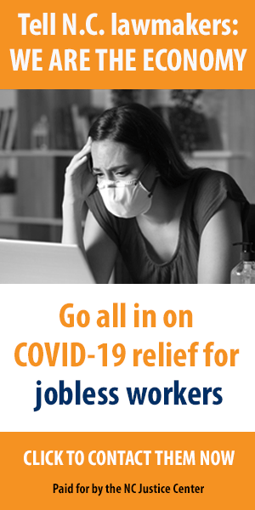
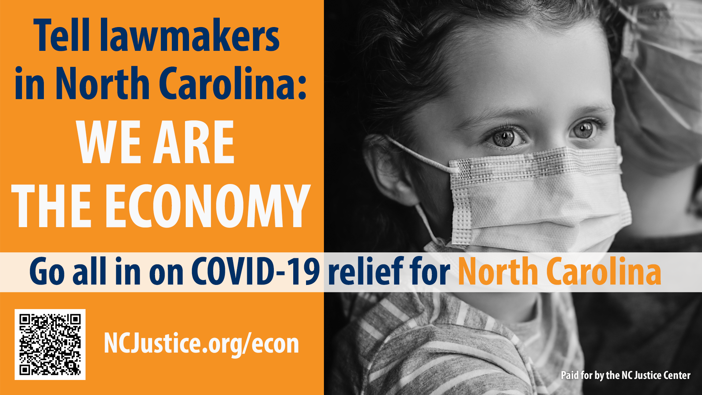
Digital Advertising

Slide 10
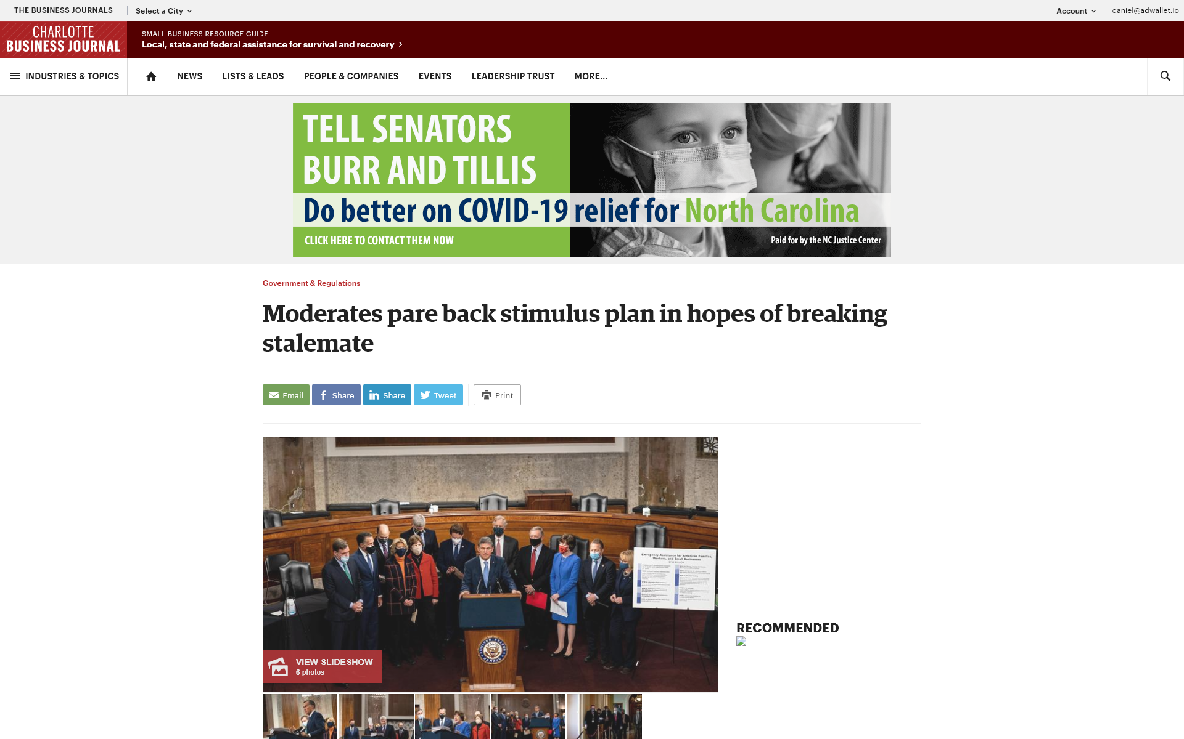
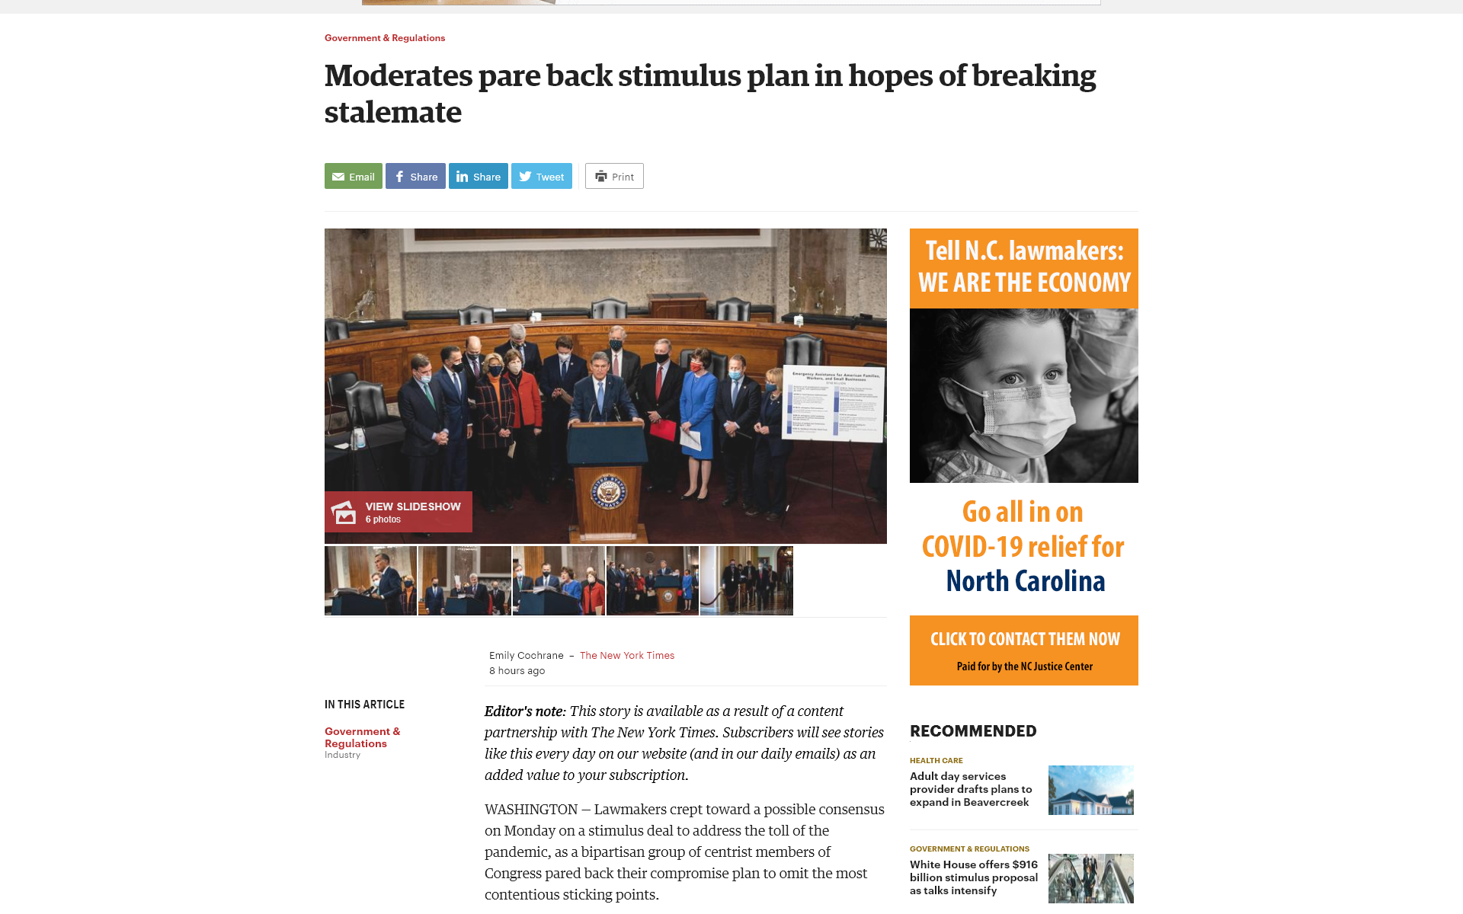
Digital ad buys in Triangle and Charlotte Business Journals
XL Banners:
89,149 Impressions Delivered
0.​11% CTR
Homepage takeover:
157,508 Impressions Delivered
0.​13% CTR

Slide 11
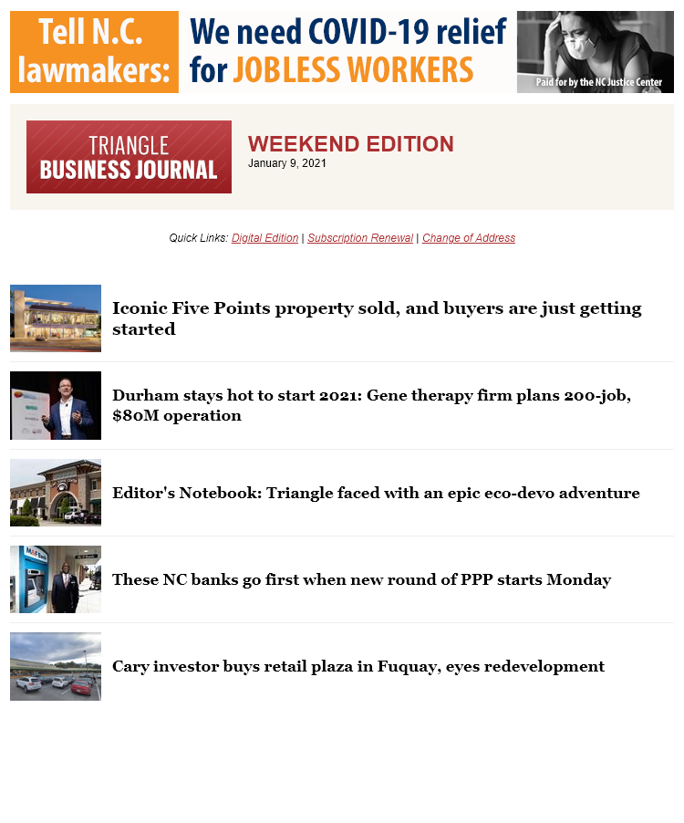
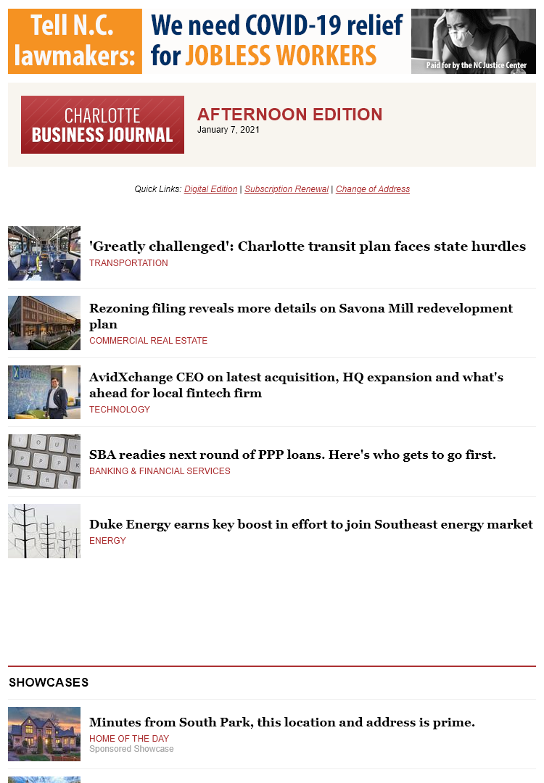
Digital ad buys in Triangle and Charlotte Business Journal newsletters
123,763 Impressions Delivered
0.​27% CTR

Slide 12
Digital ad buys in Triangle and Charlotte Business Journal newsletters
Total Campaign Impressions Delivered: 370,420
Total Campaign Clicks: 642
Overall CTR: 0.17% ​
Overall, the NC Justice campaign performed within The Business Journals’ averages for all products.
Through this campaign, NC Justice was exposed to the Triangle and Charlotte Business Journal audience for over 300 total hours.
On average, users were interacting with the digital creative for about 5 seconds, which resulted in total interaction of 5 hours.
This campaign reached a high affluent audience, including users who are likely associated with a political affiliation.

Slide 13
Facebook ad buys
$6,000 budget
13,569 link clicks
215,935 people
770,124 impressions
$0.44 per link click
$1.72 avg per link, clink all industries

Slide 14
Facebook lead ad buys: More targeted = * more $ * more engaged
$1,500 budget – activist inclined targets
233 On-Facebook Leads
34,456 People
68,453 Total
$6.44 Per On-Facebook Leads
Targeted:
Interests: Black Lives Matter, Southern Poverty Law Center, Social equality, American Civil Liberties Union, Social justice, Mother Jones (magazine), National Association for the Advancement of Colored People, EMILY's List
$1,000 budget – gen targets
687 On-Facebook Leads
23,869 People
48,204 Total
$1.46 Per On-Facebook Leads
$2.55 avg Facebook leads, industry
Notes:
And as you saw with the 15 Days campaign, adding those folks through FB lead ads add engaged folks

Slide 15
Text list building
Less than half (835) of the people on our text list (1,912) opened one of the 15 Days emails.
Only 75 people who clicked one of the 15 Days emails has ever clicked on a text from us.
555 people who have clicked on a text did not open any of the 15 Days emails
Jan 2020: ~400 text subscribers
March 2021: 2,178 subscribers
Notes:
We had about 400 signatures at the beginning of last week, and we needed to send it as things sped up. Urgent call to text list got it to 700 by the end of the day – and we were able to do that because of the time we spent building an engaged list last year

Slide 16
FOR MORE INFORMATION:
Mel Umbarger
mel@ncjustice.org
NCBudgetAndTax.org
@ncbudgetandtax
Notes:
Any questions?

