Slide 1
Health Advocacy Project
Nicole Dozier, Director Rebecca Cerese, Policy Advocate
Nicole@ncjustice.org Rebecca@ncjustice.org

Slide 2
Major Successes 2021
Federal Advocacy
American Rescue Plan Act; Included major fiscal incentive to the remaining non-expansion states to expand Medicaid
Build Back Better Act; Final package includes federal plan to temporarily close the coverage gap for three years

Slide 3
Major Successes 2021
Community Engagement – NC Photo Voice Project
Advocacy through photography with community members in Fayetteville and Durham

Slide 4
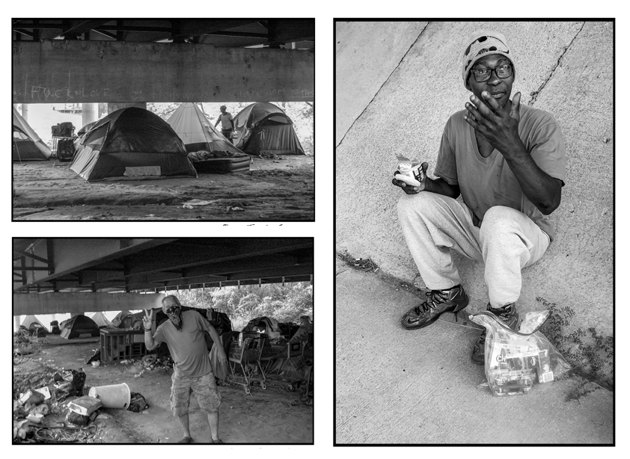
Community Engagement – NC Photo Voice Project - Fayetteville

Slide 5
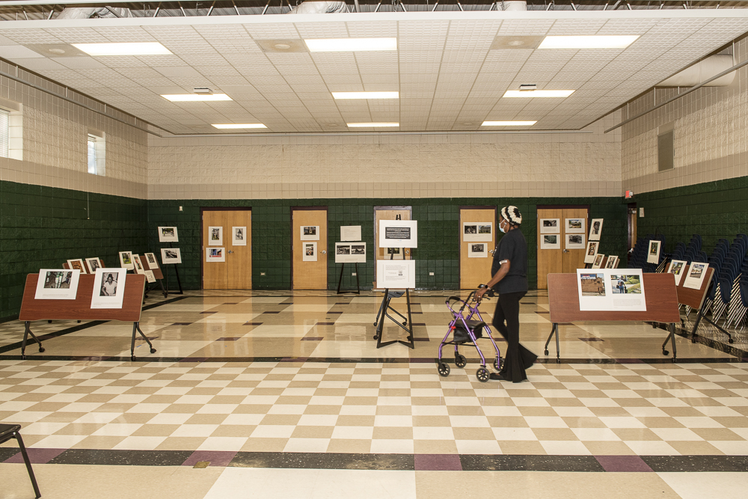
Fayetteville Photography Exhibition

Slide 6
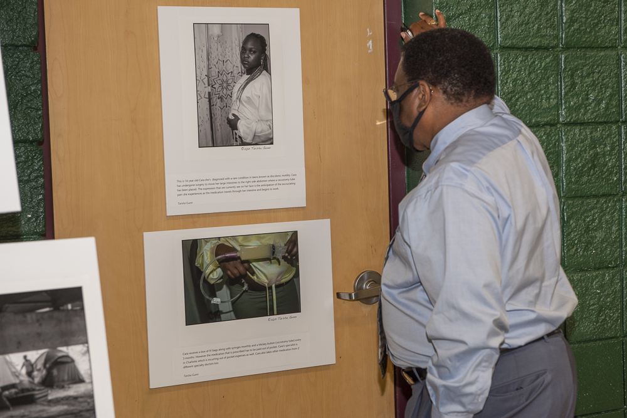
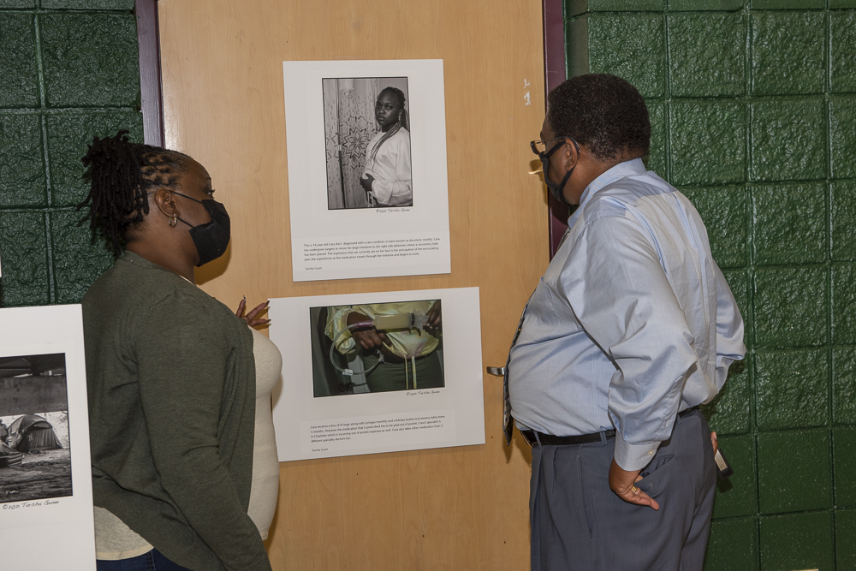
Fayetteville Photography Exhibition
Photo Voice created an opportunity for the participants to advocate directly to their elected officials for policy changes they wanted to see in their communities

Slide 7
Successes 2021
State Advocacy for Medicaid Expansion
Hundreds of phone calls
Shared many powerful personal stories of North Carolinians in the Medicaid gap
Direct actions like the Funeral Procession in front of the NCGA
Supported a letter to editor campaign
Tweetstorms/Social Media campaigns
WRAL spotlight campaign
Earned Media
Although we didn’t get Medicaid expansion this year – we moved closer to the goal, and will continue the fight

Slide 8
Looking Ahead to 2022: Major Campaigns
Joint Legislative Committee on Medicaid Expansion
Reducing Medical Debt
2022 Elections

