Slide 1

IMMIGRANT & REFUGEE RIGHTS PROJECT
2021 IN BRIEF

Slide 2
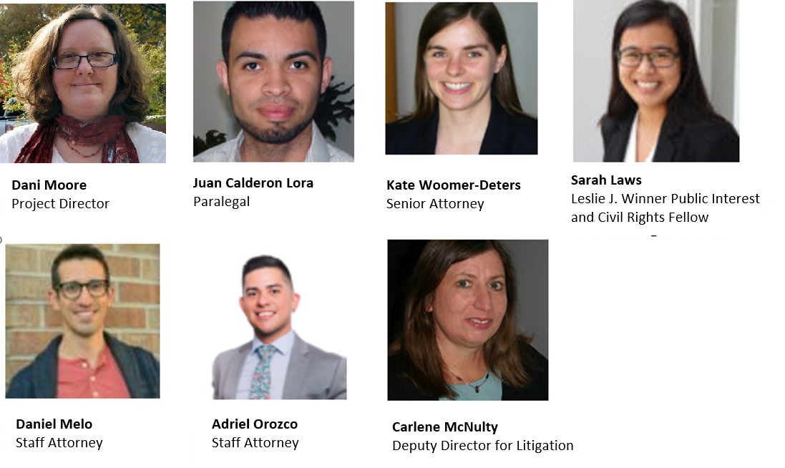
Our team:
IMMIGRANT & REFUGEE RIGHTS PROJECT

Slide 3
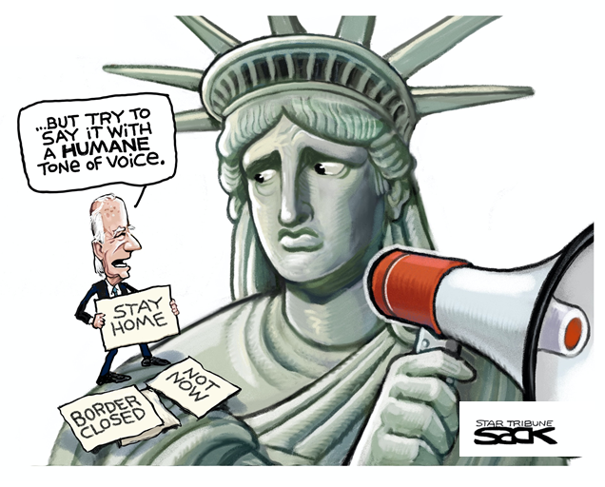
Immigrant Rights Landscape - Federal
Many big victories...
  End of the expanded public charge rule
  Decreased immigration enforcement
  Some COVID-19 stimulus aid excludes undocumented community
But many obstacles remain
  Title 42 (Trump-era policy)
  Remain in Mexico (Trump-era policy)
IMMIGRANT & REFUGEE RIGHTS PROJECT

Slide 4
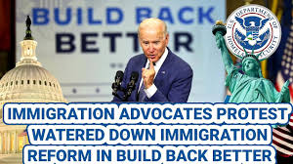
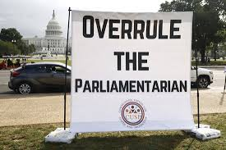
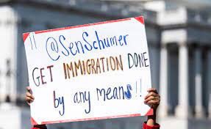
IRRP’s Work - Federal
Advocating for expansive immigration relief
  Build Back Better Act
    Pathway to citizenship
    Lobbying House members
    Media interviews
Direct Representation
    Represent asylum seekers,
    TPS holders, survivors of crime
IMMIGRANT & REFUGEE RIGHTS PROJECT

Slide 5
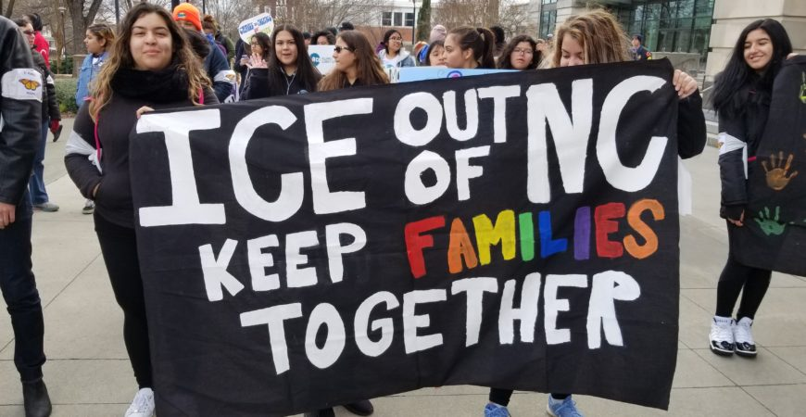
Immigrant Rights Landscape - State
Anti-immigrant legislation
  SB 101 – require sheriff cooperation
  with ICE
  HB 62 – Punish “Sanctuary Cities” by
  creating private cause of action
  HB 29 – Prohibit access to public benefits and professional licenses
  HB 259 – Use noncitizen jury excusals to screen voter rolls
COVID-19, public health, income support and housing
  Lack of support for immigrant community
Image from El Pueblo, Inc.
IMMIGRANT & REFUGEE RIGHTS PROJECT

Slide 6
IRRP’s Work – State
Anti-immigrant legislation
  Successfully lobbied against passage of harmful bills
  Created talking points and joined community presentations
  about bills
  Radio shows
COVID-19 health, public benefits, income support
  Created informational sheets and videos
  Media interviews
  Outreach and educational events for community, public
  health agencies, nonprofits
Housing
  Lawsuits against mobile home park for unlawful evictions of immigrant residents
  Represented undocumented immigrants in evictions proceedings
  Advocated with several counties to include immigrants in rental relief programs
IMMIGRANT & REFUGEE RIGHTS PROJECT

Slide 7
IRRP: Looking ahead to 2022
Litigation
  Continue representation of immigrants for immigration relief
  and pursue lawsuits to address constitutional rights violations
Administrative advocacy
  Continue advocating for expanding eligibility for in-state
  tuition and timely adjudication of USCIS applications
Policy advocacy – State
  Monitor and defend against anti-immigrant bills
Policy advocacy – Federal
  Pushing for Senate passage of Build Back Better Act with path to citizenship
IMMIGRANT & REFUGEE RIGHTS PROJECT

