Slide 1

EDUCATION & LAW PROJECT
Matthew Ellinwood, Director
Kris Nordstrom, Sr. Policy Analyst
Sarah Montgomery, Sr. Policy Advocate

Slide 2

Communities for the Education of Every Child NC
www.everychildnc.org info@everychildnc.org
@everychildnc #LeadWithLeandro
EDUCATION & LAW PROJECT

Slide 3







Every Child NC
8 Organization Member-Led Coordinating Committee
+ 36 organization partners
EDUCATION & LAW PROJECT

Slide 4
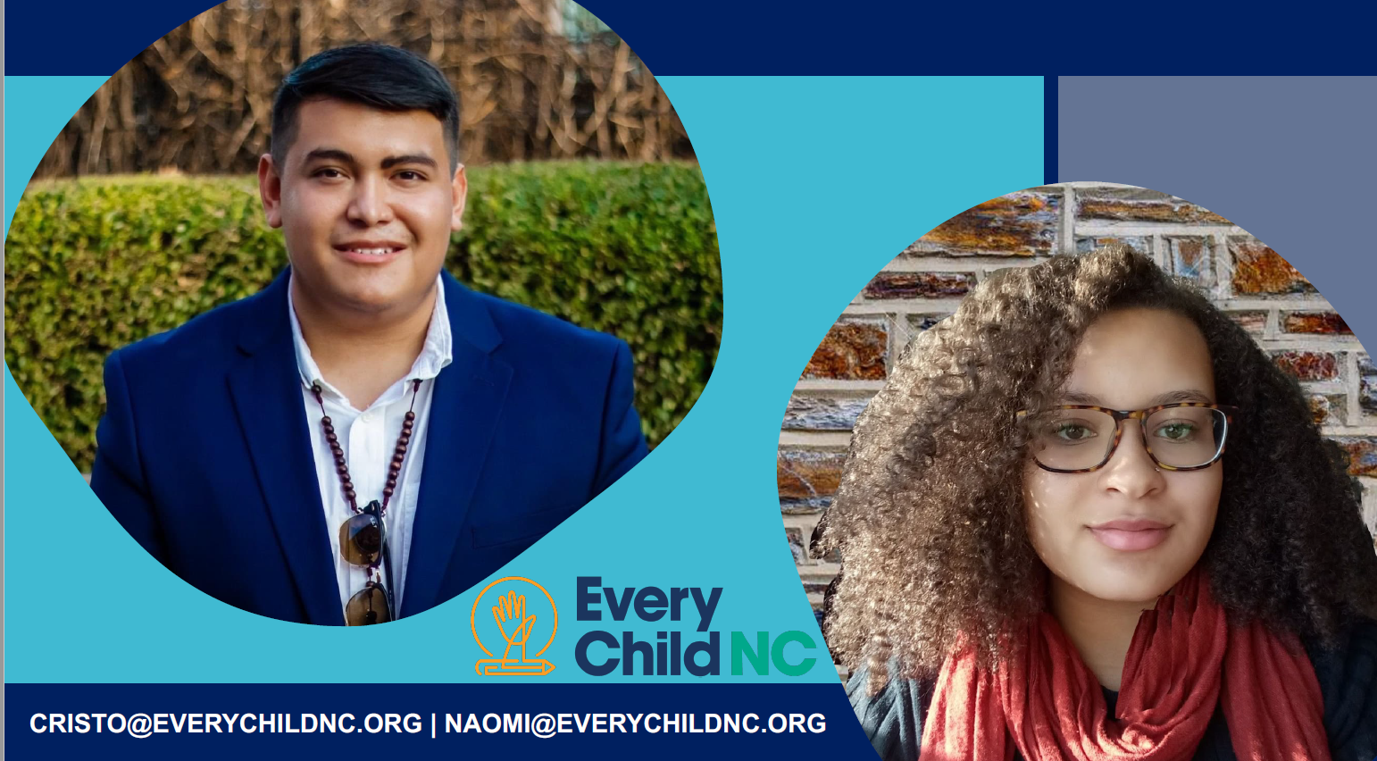
EDUCATION & LAW PROJECT

Slide 5

Every Child NC
Capacity Building:
Hired Naomi & Cristo!
Advocate network growth & strengthening partnerships
Grew our Coordinating Committee (to 8 org members)
Launched the Partner Support Fund (8 mini-grants totaling $37,150)
EDUCATION & LAW PROJECT

Slide 6
Every Child NC
Building Power:
Solidified coalition’s central role in leading the equitable
school funding fight
Elevated the conversation
Will continue to make Leandro a key election issue and mobilize our communities for the fight ahead
EDUCATION & LAW PROJECT

Slide 7
Every Child NC
Policy Outcomes:
Shaped and informed the Leandro Plan
to ensure needs of historically marginalized communities are prioritized
Gov. Cooper included full funding for Leandro Plan in his budget
Compromise budget *does* include more funding than would have otherwise been included
530 advocates took action with 1,445 contacts made to lawmakers calling for full funding of Leandro plan.
8 School Boards & 2 County Commissions passed local resolutions
EDUCATION & LAW PROJECT

Slide 8
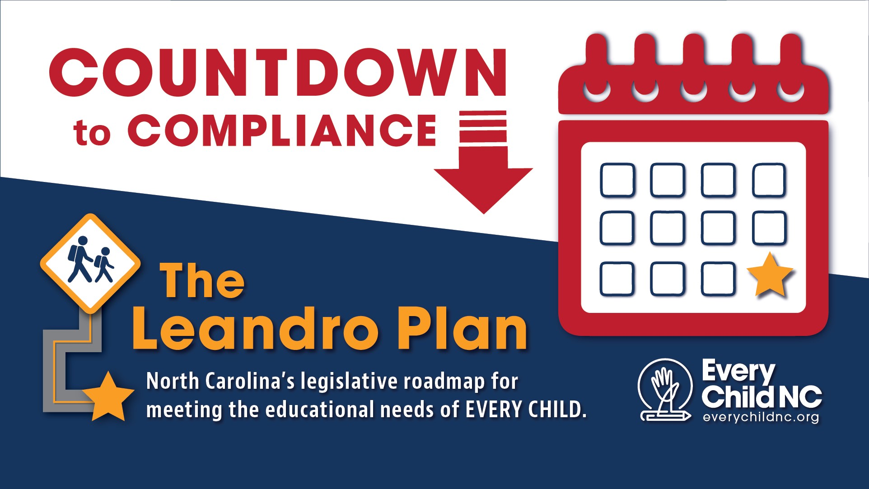
EDUCATION & LAW PROJECT

Slide 9
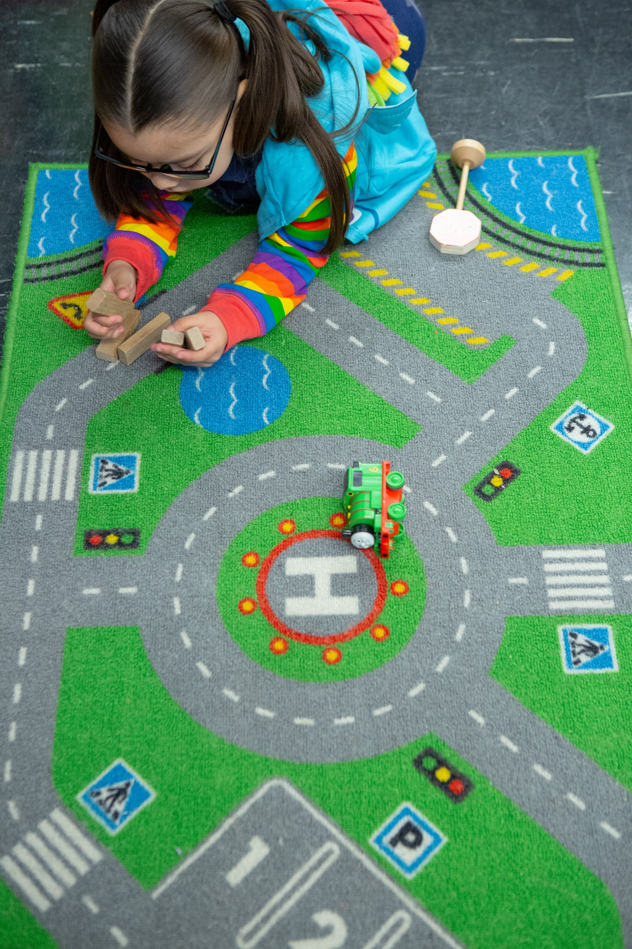
Every Child NC
The leandro plan provides a road map for getting North Carolina closer to realizing education equity
EDUCATION & LAW PROJECT

Slide 10

Every Child NC
Join Our Movement!
EDUCATION & LAW PROJECT

